Slide 1



The brown alga model for functional and evolutionary analysis of sex determination
CORMIER Alexandre
PhD

Slide 2

Visualisation des données
http://mmodev.sb-roscoff.fr/jbrowse/
Gènes d’interets:
Ec-00_00000
Ec…

Slide 3


Provide a public repositories for DNA sequencing data, especially the "short reads" generated by High-throughput sequencing.
Journals require that DNA and RNA sequencing data is made available online.

Slide 4
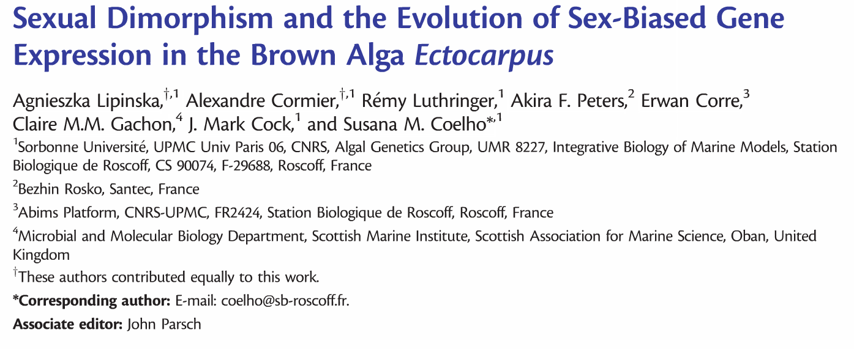
doi:10.1093/molbev/msv049

Slide 5
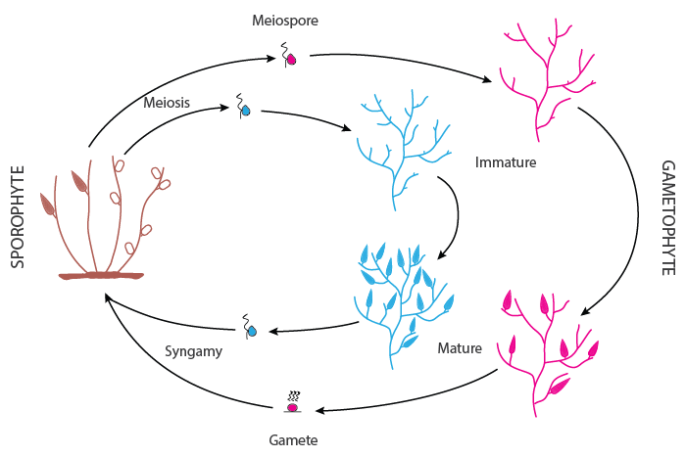
Male and female near-isogenic lines (inbred for 8 generations)
GA immature male
GA immature female
GA mature male
GA mature female

Slide 6
Trouver les différentes librairies RNA-seq utilisés dans l’article sur le site web NCBI SRA
Nombre d’échantillons et de réplicats ?
Nombre de reads / réplicat ?

Slide 7

Cond. 1 Cond.2 Cond.3
Gene_1 10 25 600
Gene_2 27 35 40
…
Gene_n 85 12 55

Slide 8
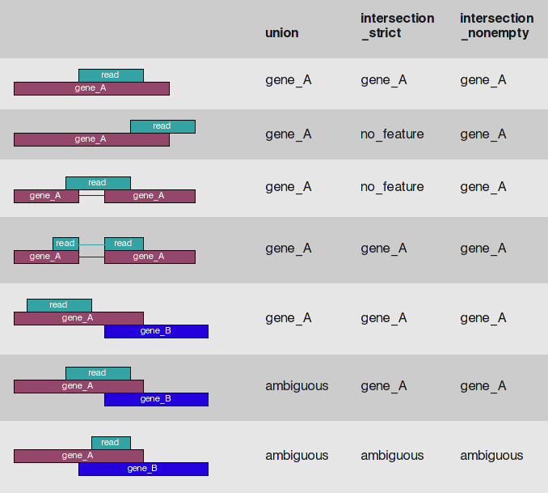

Slide 9
https://bioconductor.org/packages/release/bioc/html/DESeq2.html

